Slide 1
Project B: Image Inpainting
Jannes Weghake

Slide 2
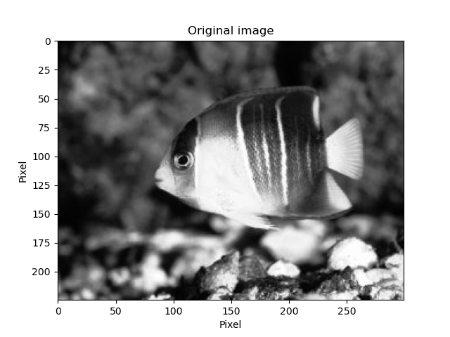

Laplace Equation $ΔI=0$

Slide 3
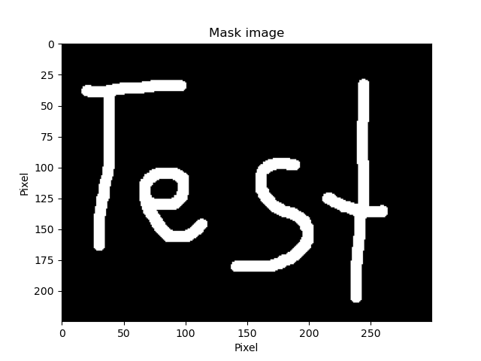
Laplace Equation $ΔI=0$

Slide 4
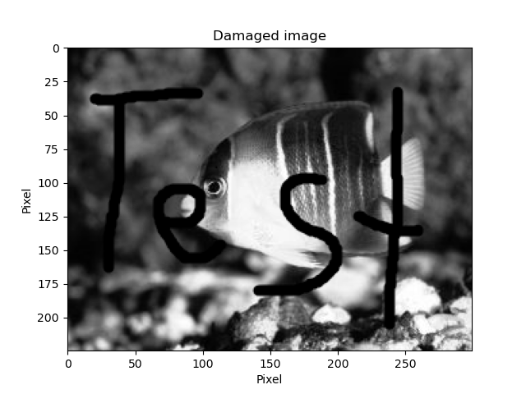
Laplace Equation $ΔI=0$

Slide 5
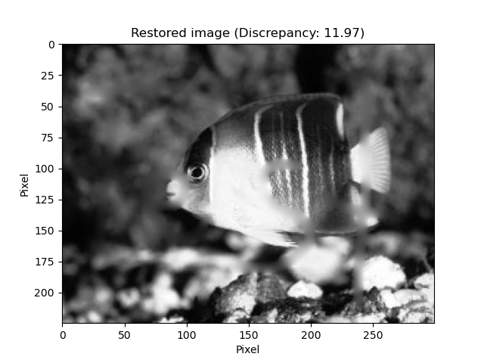
Laplace Equation $ΔI=0$

Slide 6

Image inpainting along isophotes ^{[1]}: Navier-Stokes Equation
Based on Paper „Navier-Stokes, Fluid Dynamics, and Image and Video Inpainting “ ^{[1]}
Propagates isophotes from the intact image region into the damaged region
Isophotes: Lines with least amount of change of image intensity $I$
Notes:
The approach uses ideas from classical fluid dynamics to propagate isophote lines continuously from the exterior into the region to be inpainted. The main idea is to think of the image intensity as a ‘stream function’ for a two-dimensional incompressible flow. The Laplacian of the image intensity plays the role of the vorticity of the fluid; it is transported into the region to be inpainted by a vector field defined by the stream function. The resulting algorithm is designed to continue isophotes while matching gradient vectors at the boundary of the inpainting region. The method is directly based on the Navier-Stokes equations for fluid dynamics, which has the immediate advantage of well-developed theoretical and numerical results.

Slide 7

Image inpainting along isophotes ^{[1]}: Navier-Stokes Equation
Smoothness $ω$ of the image intensity $I$:
$ΔI= ω$
Project gradient of $ω$ along the isophotes:
$$I_{t}=∇⊥I⋅∇ΔI=0 (steady state)$$
=> Transport equation convecting the image intensity along the smoothness level lines
Add anisotropic diffusion:
$$I_{t}=∇⊥I⋅∇ΔI+ν∇⋅(g\left(\left|∇I\right|\right)∇I)$$

Slide 8
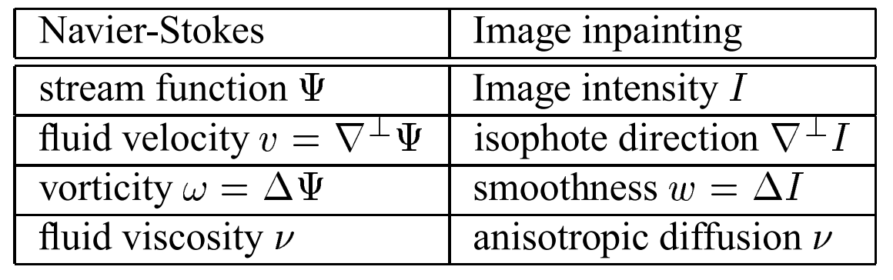
Image inpainting along isophotes ^{[1]}: Navier-Stokes Equation
Table from [1]
Notes:
Similarity between the stream function in a 2D incompressible fluid and the role of image intensity function I in the inpainting

Slide 9

Image inpainting along isophotes ^{[1]}: Navier-Stokes Equation
Vorticity stream form of the Navier-Stokes equation:
$ω_{t}+\overset{⃑}{v}⋅∇ω=νΔω$
Adapted vorticity transport equation for image inpainting:
$$\frac{∂ω}{∂t}+\overset{⃑}{v}⋅∇ω=ν∇⋅(g\left(\left|∇ω\right|\right)∇ω)$$
with $ω=ΔI, \overset{⃑}{v}= ∇⊥I$
=> Euler time step:
$$ω_{n+1}=ω_{n}+Δt [−\overset{⃑}{v}⋅∇ω_{n}+ν∇⋅\left(g\left(\left|∇ω_{n}\right|\right)∇ω_{n}\right)]$$

Slide 10

Image inpainting along isophotes ^{[1]}: Procedure
Calculate $ω_{x,y}^{n}$for n=0 fo all undamaged pixels, guess values for damaged pixels
Solve Poisson Equation $ΔI_{x,y}^{n}=ω_{x,y}^{n} to get I_{x,y}^{n}$ for all pixels (using e.g. Jacobi-Method)
Solve ${\overset{⃑}{v^{n}}}_{x,y}=$ $∇⊥I^{n}$ for all pixels
Solve $ω_{x,y}^{n+1}=$ $ω_{x,y}^{n}+Δt(−\overset{⃑}{v}⋅∇ω^{n}+ν∇⋅(g\left(\left|∇ω^{n}\right|\right)∇ω^{n}))$ for damaged pixels
Repeat starting from step 2 with $n →n+1$

Slide 11
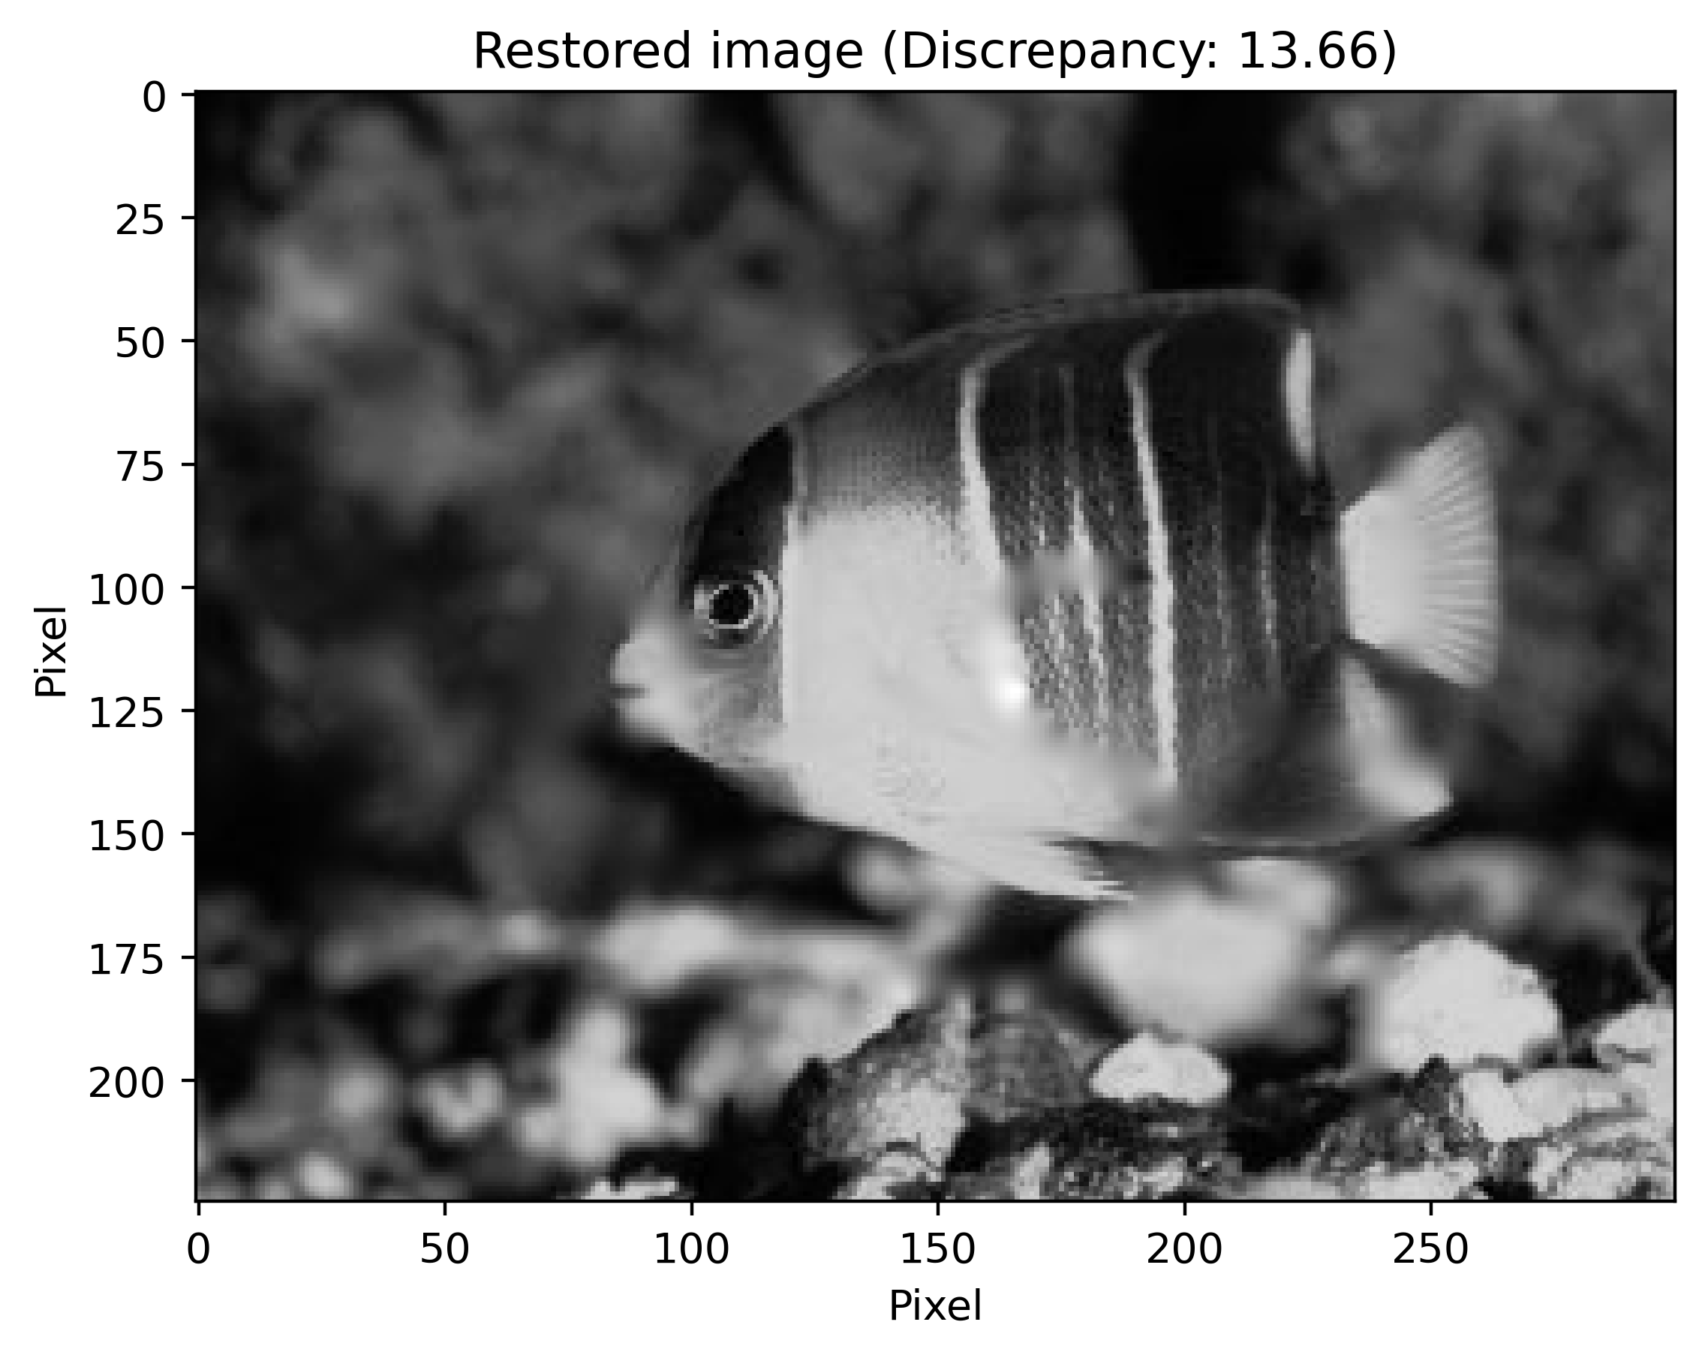
Image inpainting along isophotes ^{[1]}:
Restored using Laplace
Restored using Navier-Stokes

Slide 12
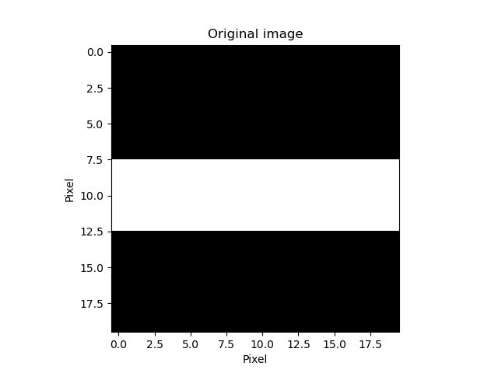
Image inpainting along isophotes ^{[1]}: Examples

Slide 13
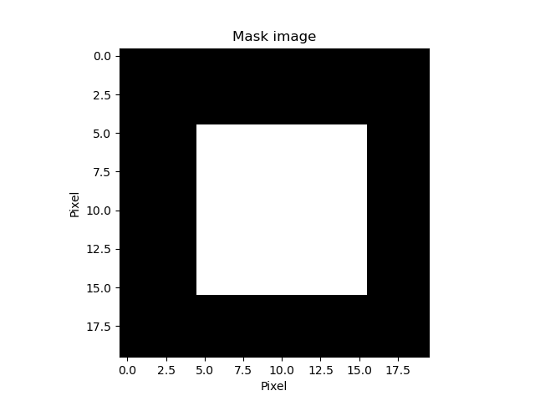
Image inpainting along isophotes ^{[1]}: Examples

Slide 14
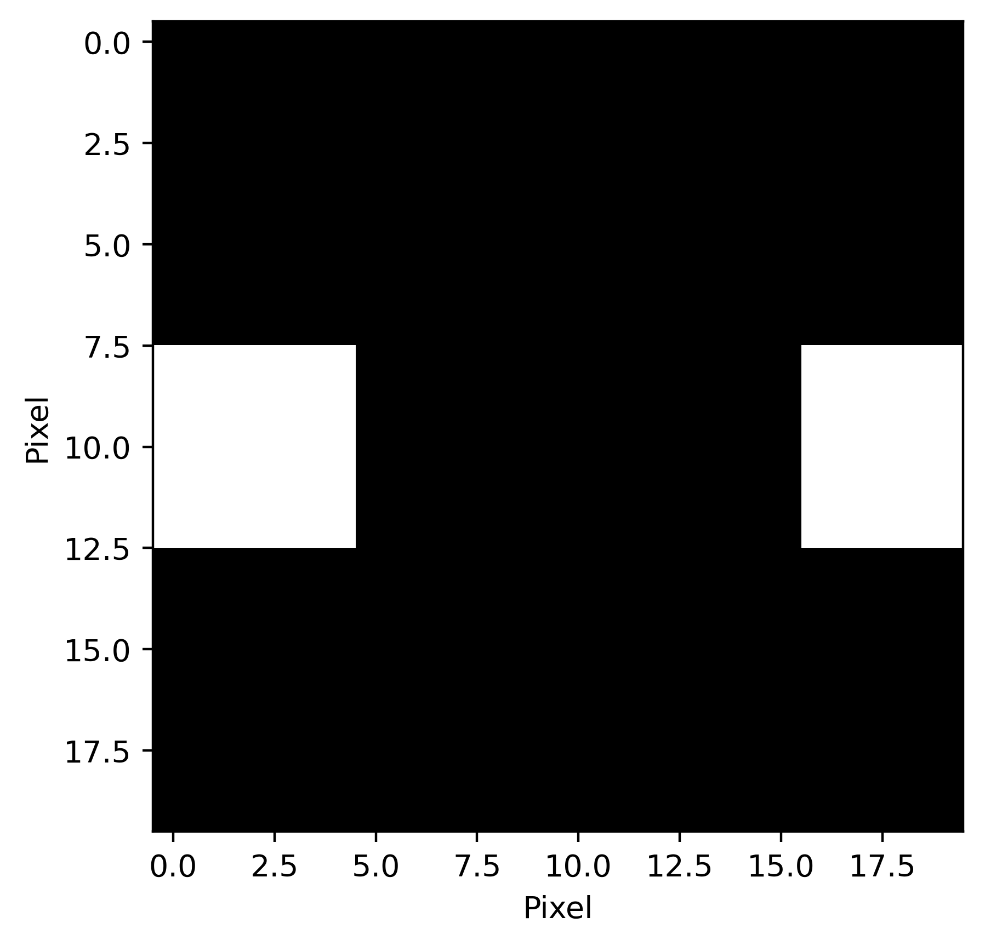
Image inpainting along isophotes ^{[1]}: Examples

Slide 15
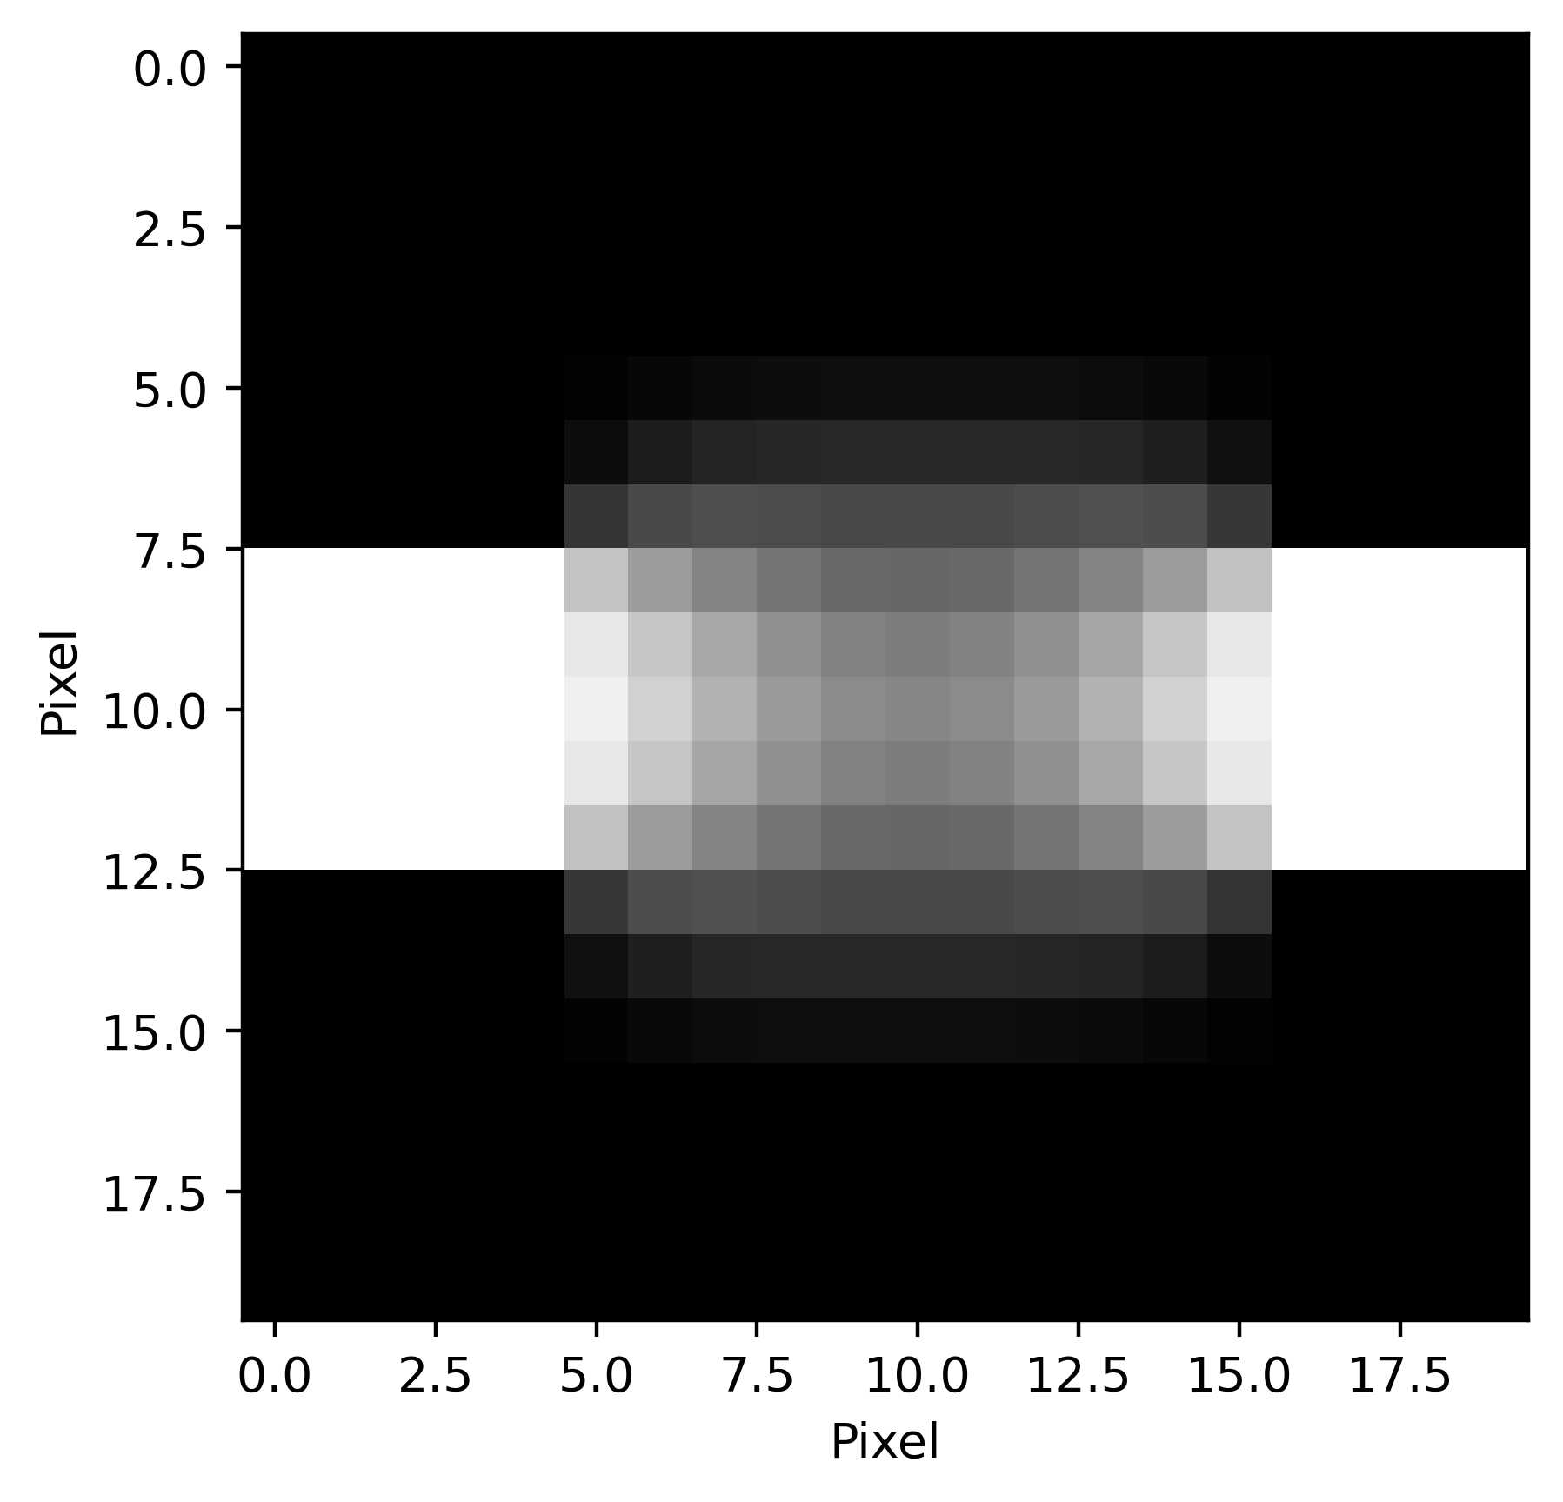

Image inpainting along isophotes ^{[1]}: Examples ($ν=2$)

Slide 16
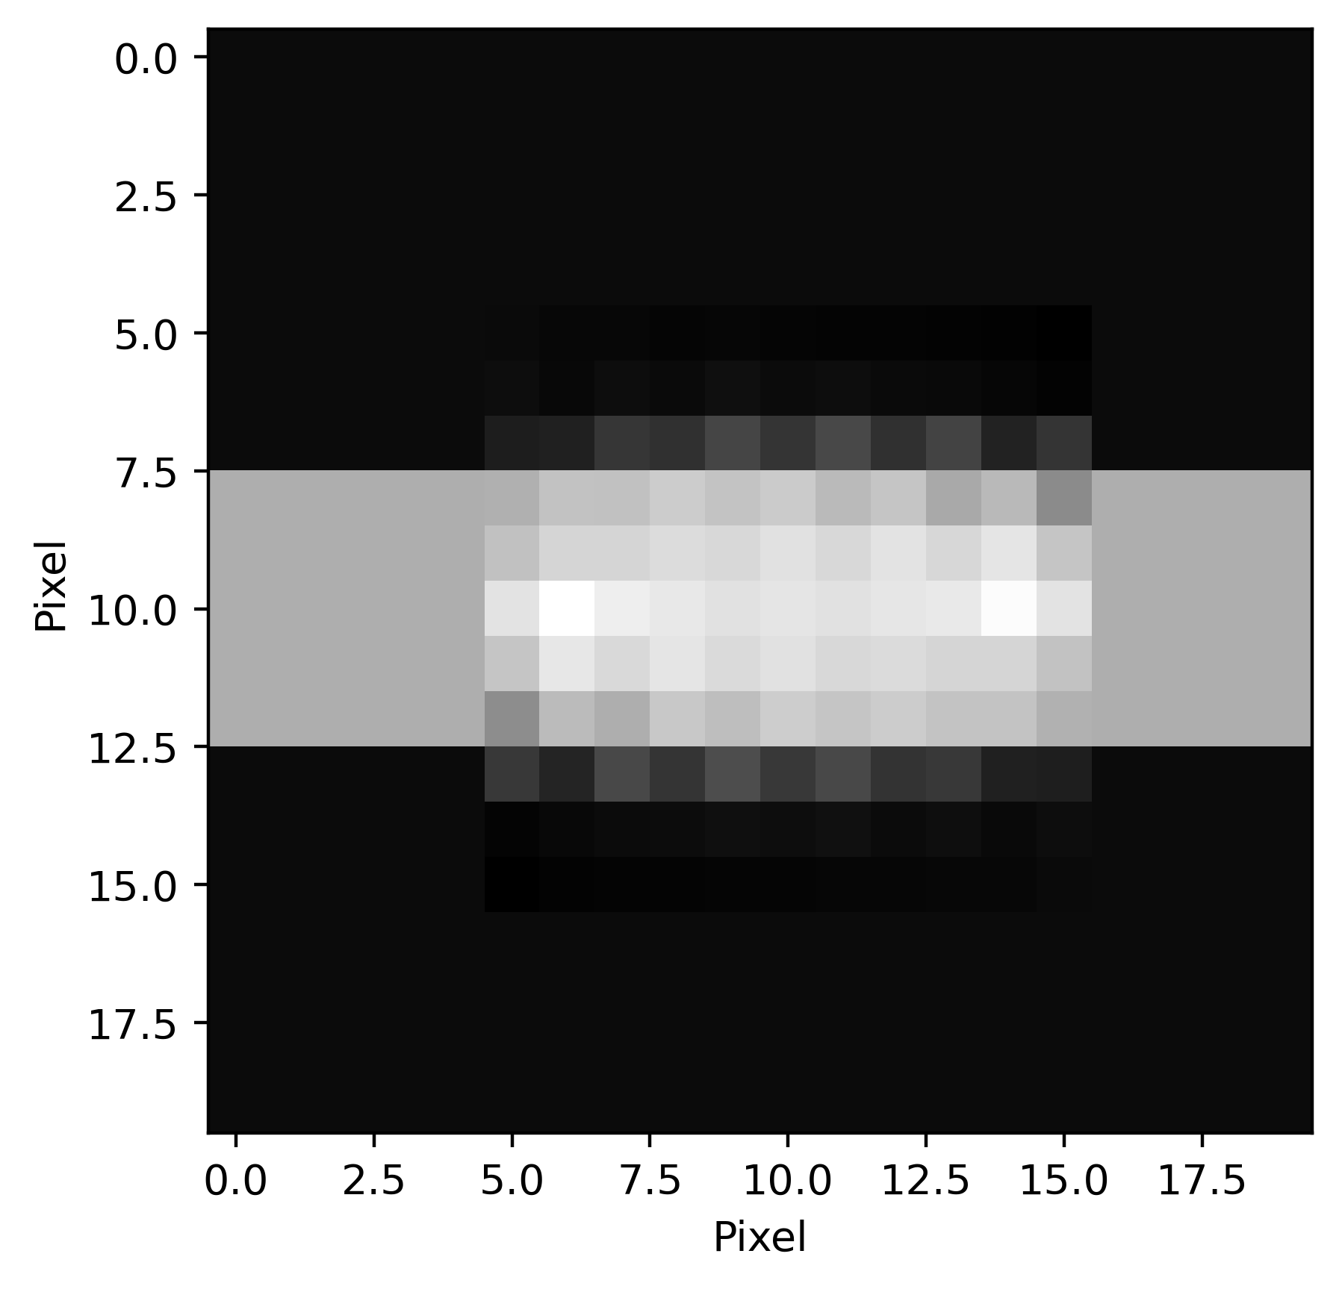

Image inpainting along isophotes ^{[1]}: Examples ($ν=0.01$)

Slide 17
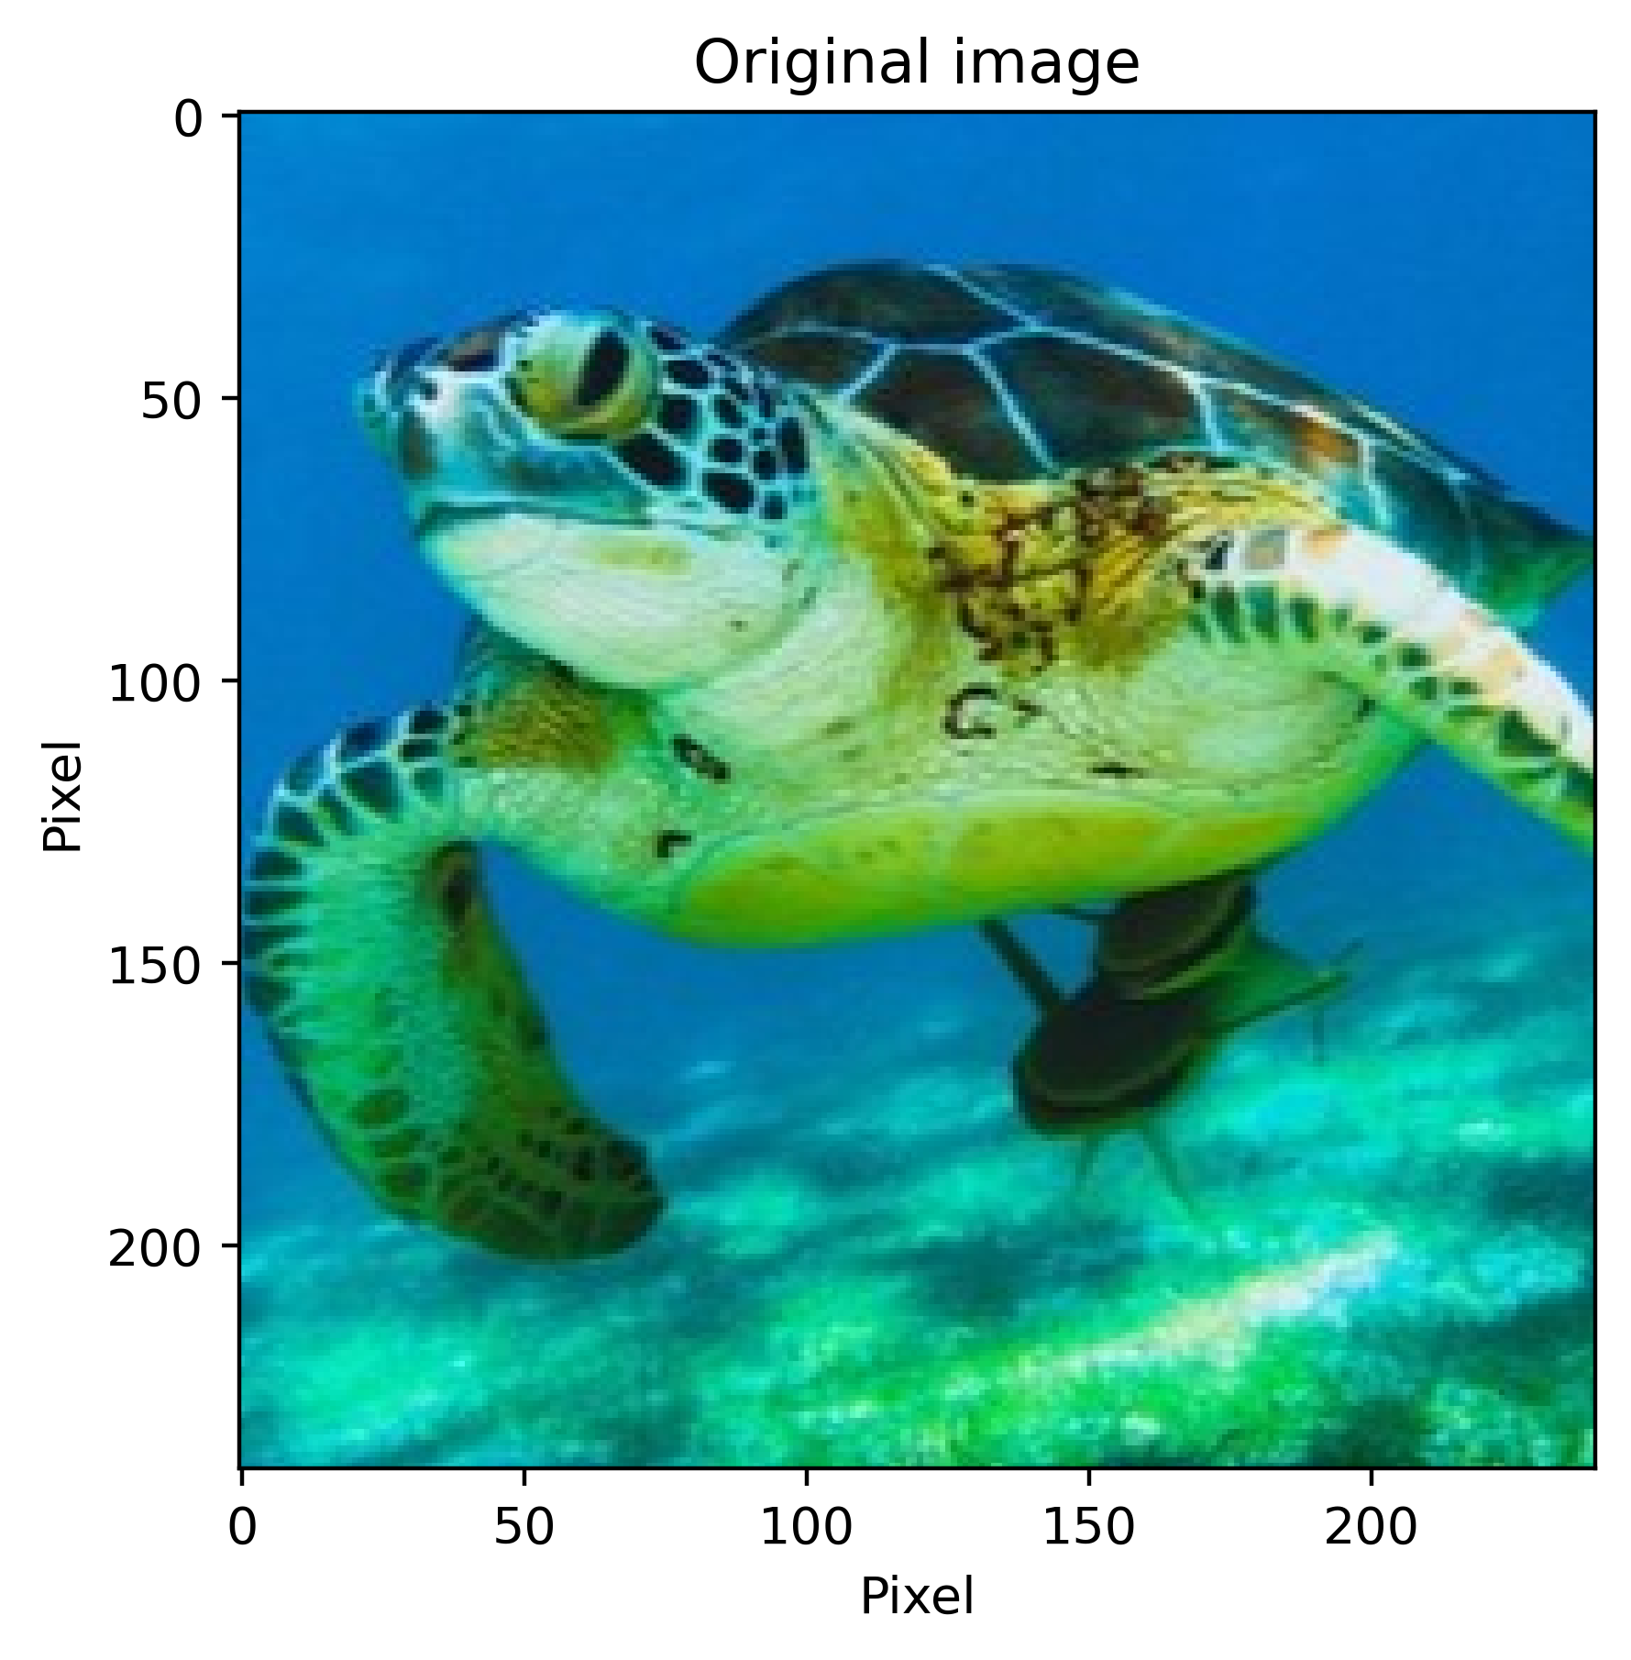
Image inpainting along isophotes ^{[1]}: Examples

Slide 18
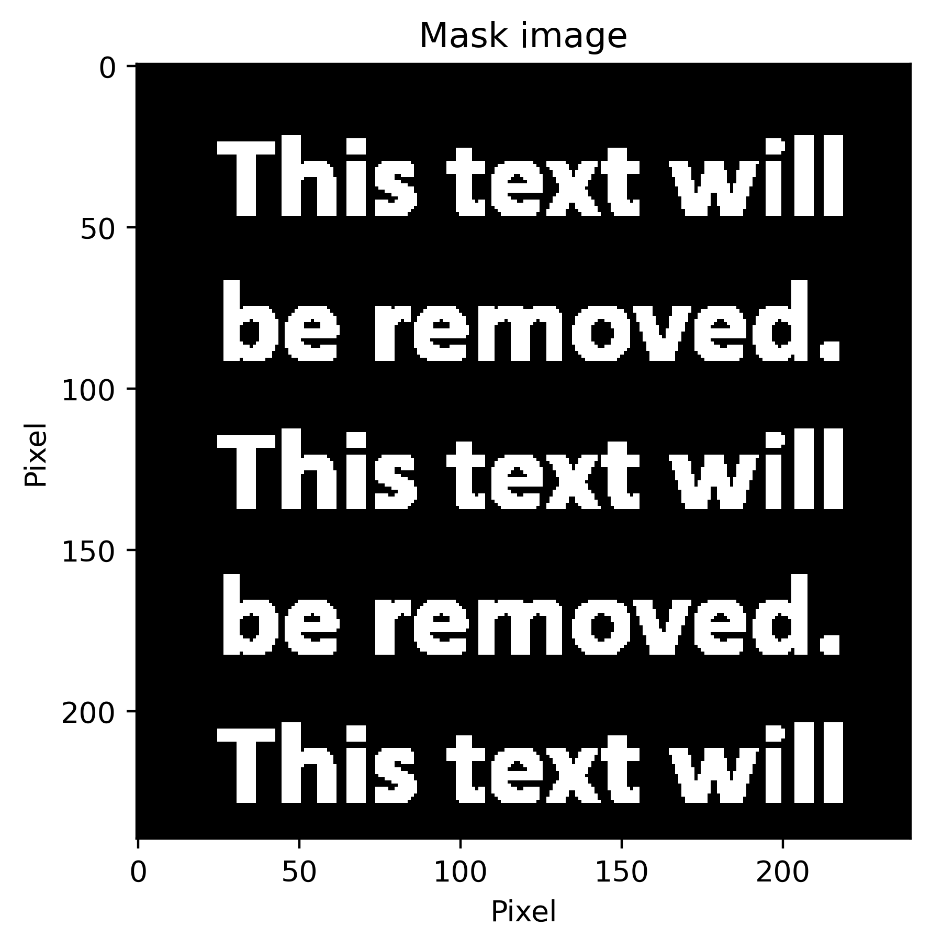
Image inpainting along isophotes ^{[1]}: Examples

Slide 19
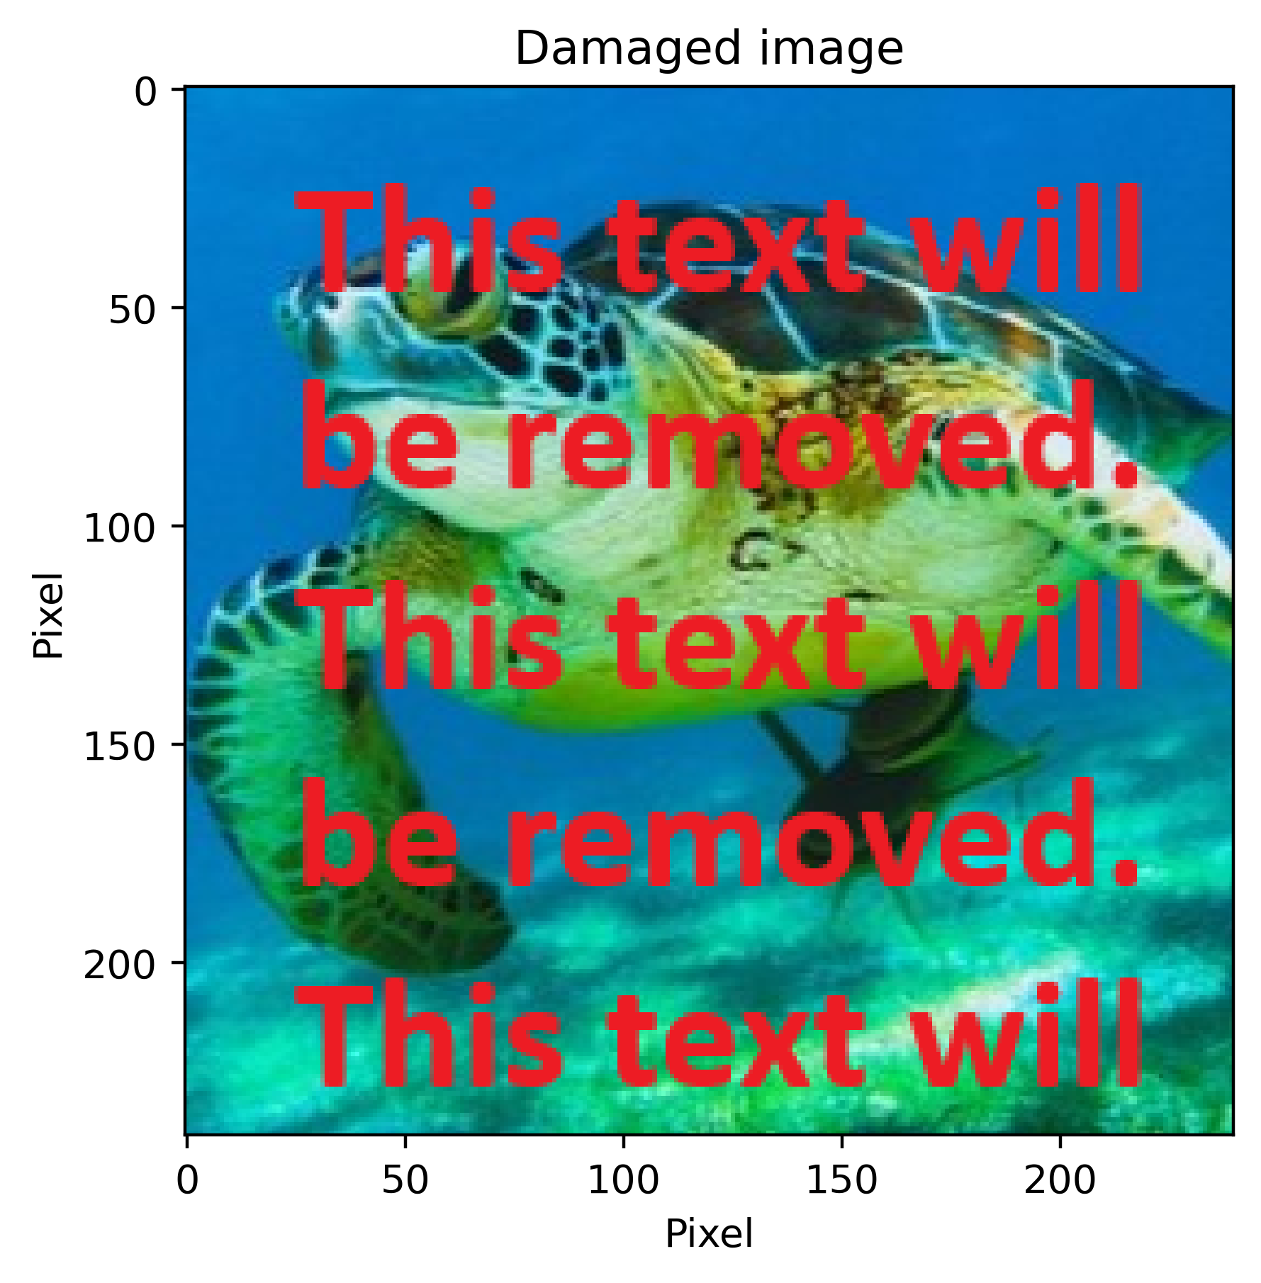
Image inpainting along isophotes ^{[1]}: Examples

Slide 20
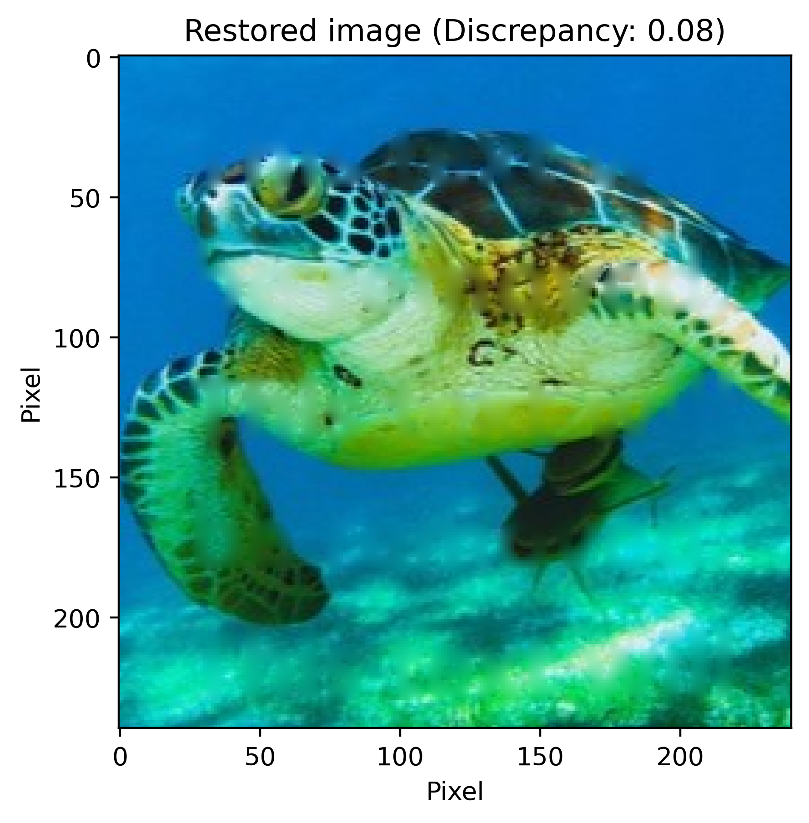

Image inpainting along isophotes ^{[1]}:
Restored using Laplace
Restored using Navier-Stokes

Slide 21
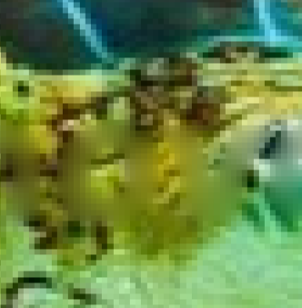
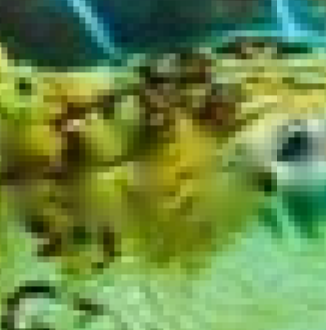
Image inpainting along isophotes ^{[1]}:
Restored using Laplace
Restored using Navier-Stokes

Slide 22
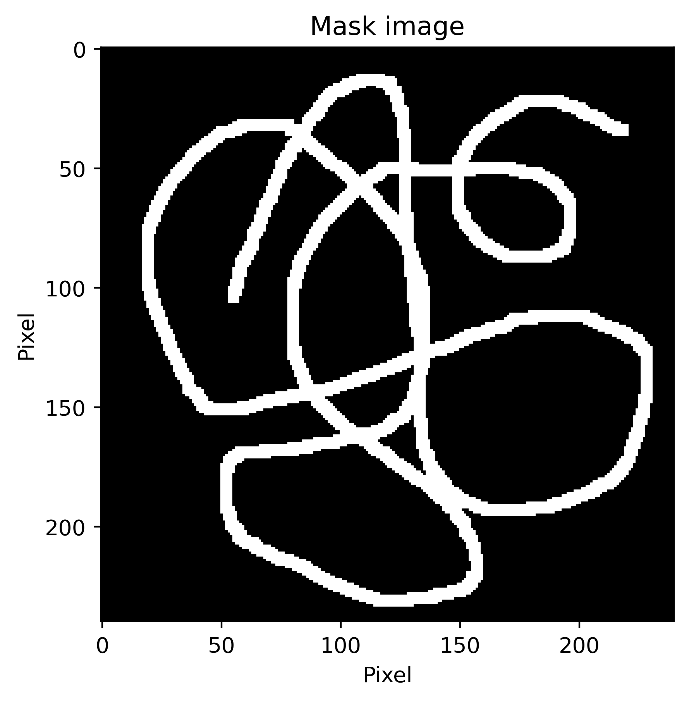
Image inpainting along isophotes ^{[1]}: Examples

Slide 23
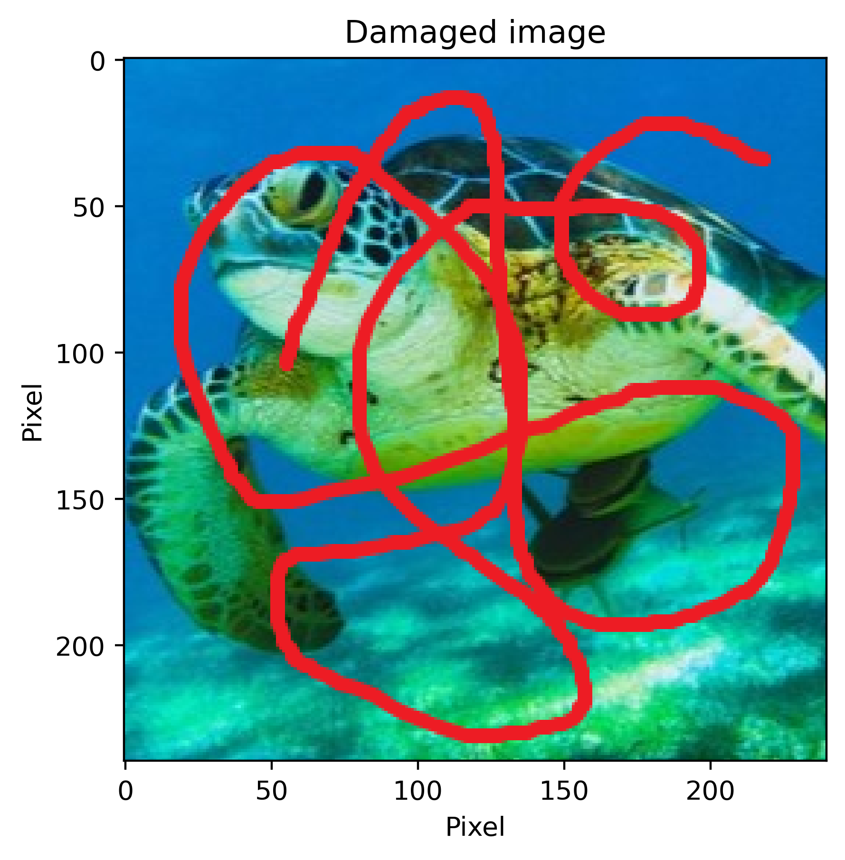
Image inpainting along isophotes ^{[1]}: Examples

Slide 24


Image inpainting along isophotes ^{[1]}:
Restored using Laplace
Restored using Navier-Stokes

Slide 25
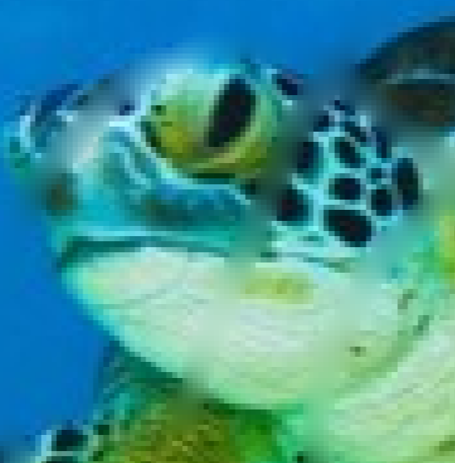
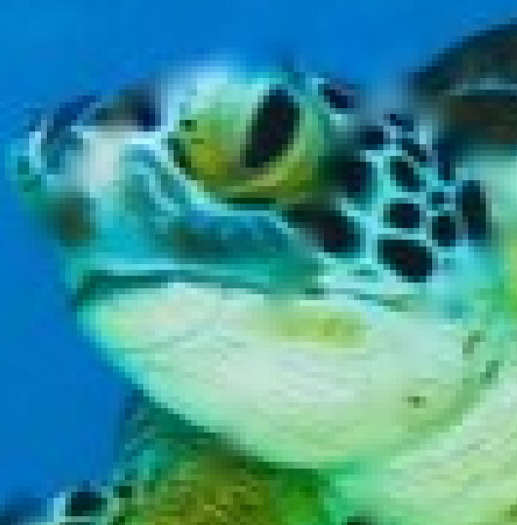
Image inpainting along isophotes ^{[1]}:
Restored using Laplace
Restored using Navier-Stokes

Slide 26

The Discrepancy score has flaws
Does not capture (original/repainted) edges and bigger structures (tortoise spots!)
Not normalized $→$ different sizes not comparable
$⟹$ use vectorial isophote directions ($= ∇⊥I$) to measure image quality
(Direction of least amount of change in intensity)

Slide 27
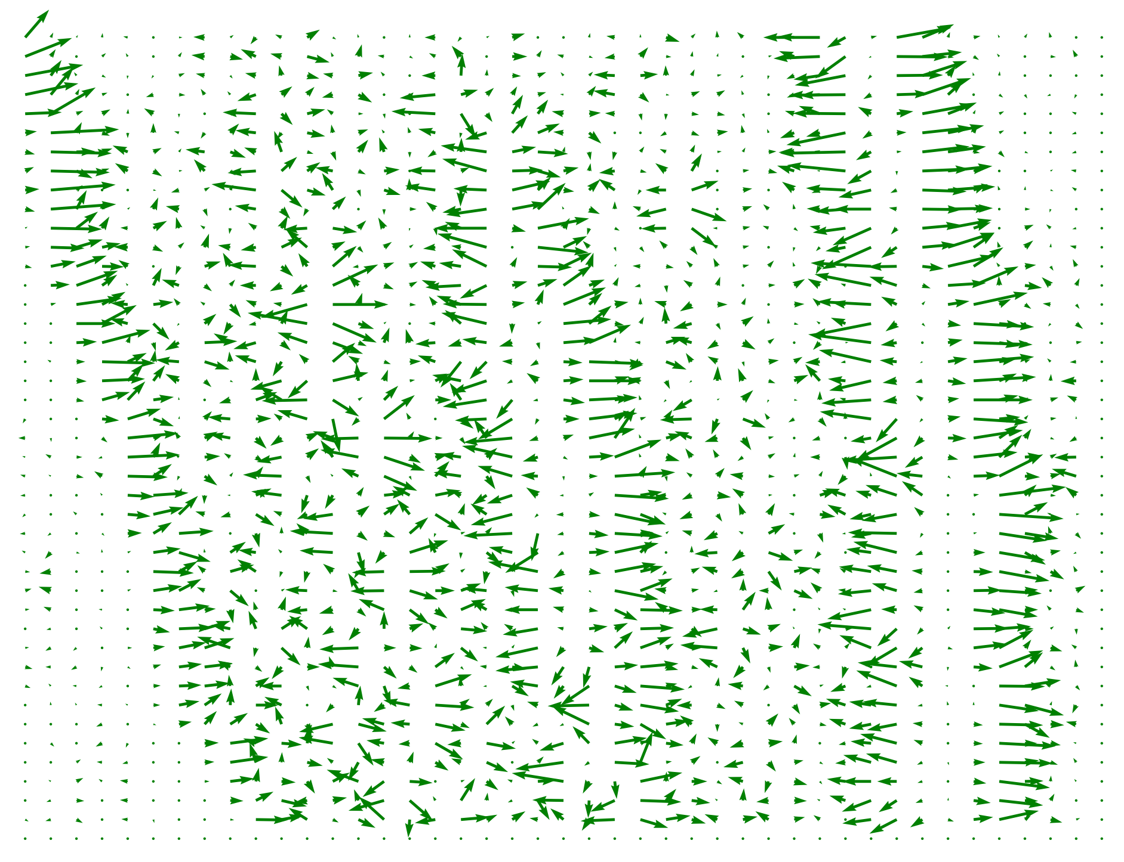
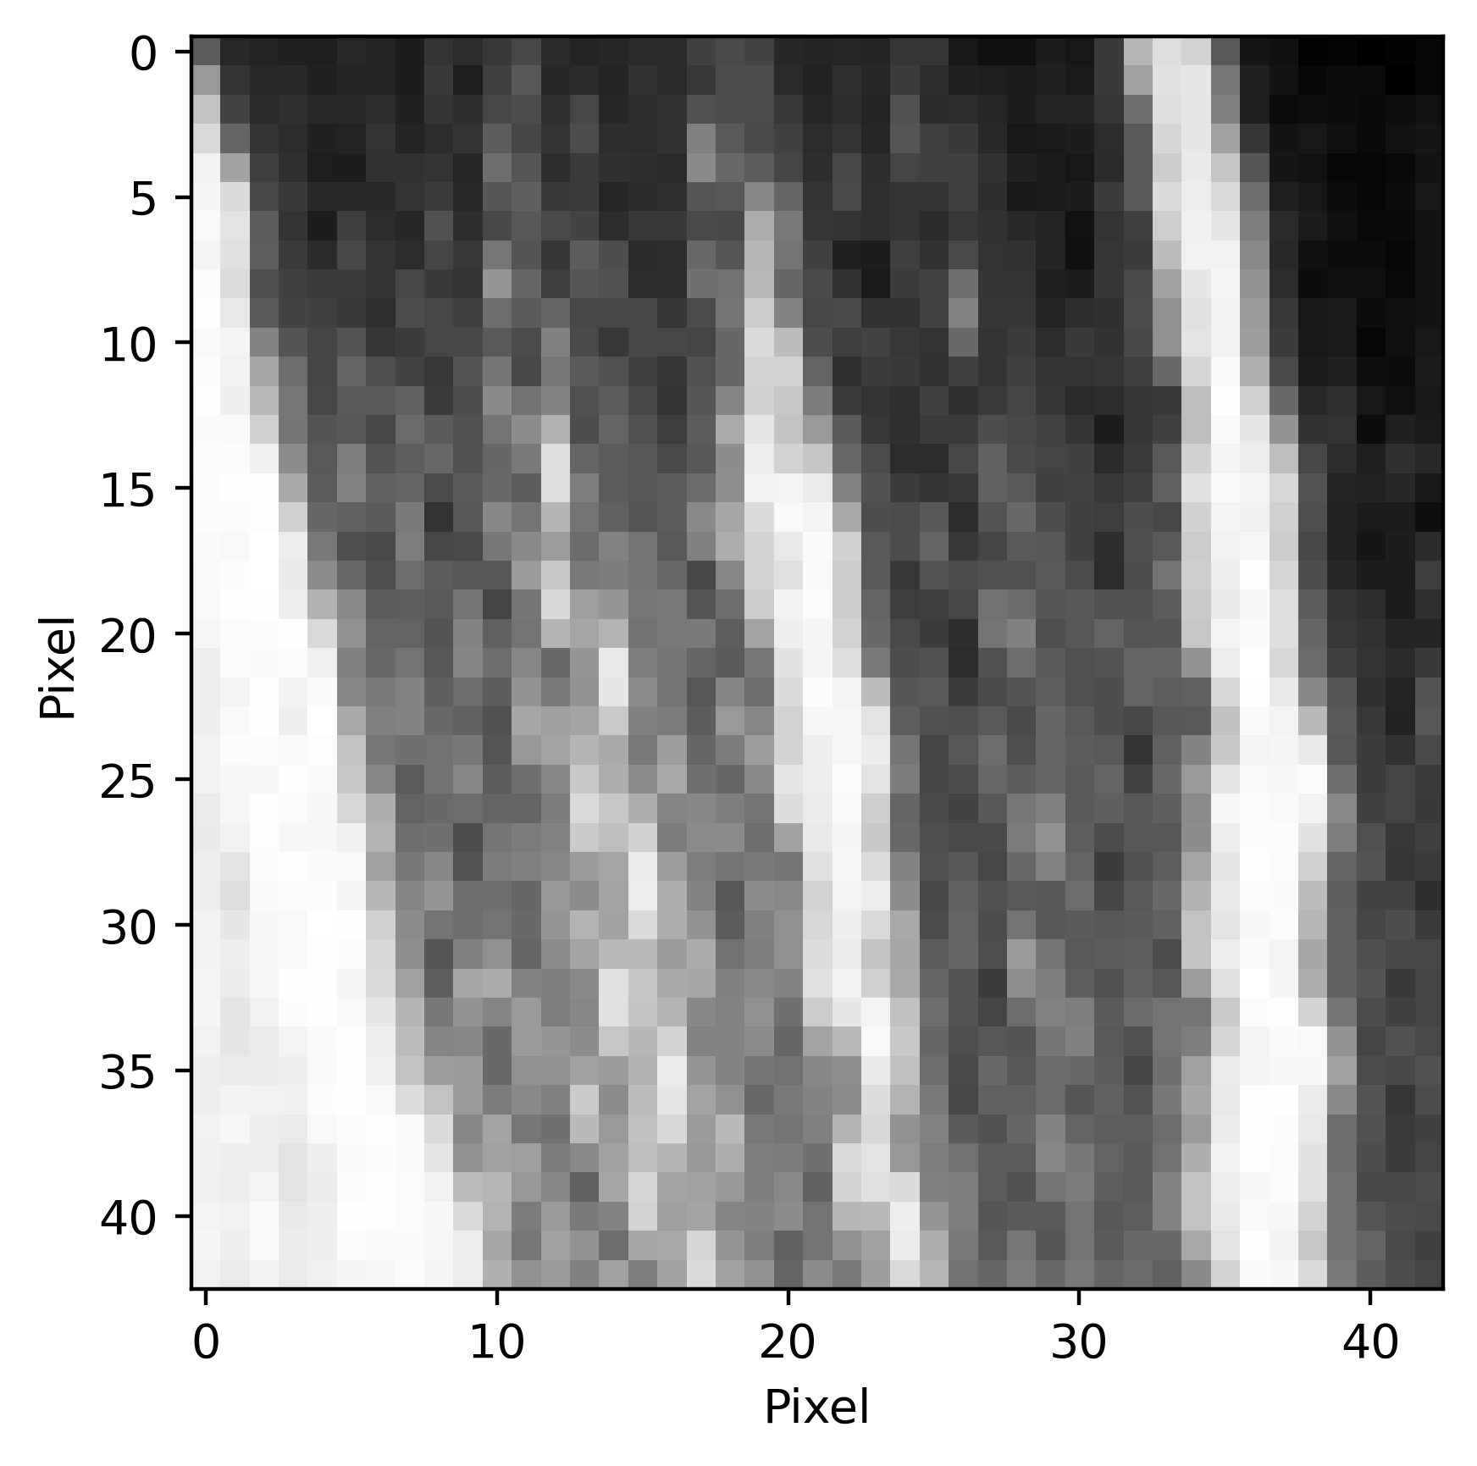
vectorfields

Slide 28

The isophote Score
$$ISO_{score}=\frac{1}{N_{dis}}\sum_{Ω}{\frac{∇⊥I_{o}\left(x,y\right)⋅∇⊥I_{r}(x,y)}{\sqrt{{\left(∇⊥I_{o}\right)}^{2}}\sqrt{{\left(∇⊥I_{r}\right)}^{2}}}}$$
Always between $−1$ and $1$
$ISO_{score}=1$ for equal pictures
$ISO_{score}≈0$ for noise

Slide 29

The isophote Score
“Physical” interpretation (for a score of 0.60
On average the angle of the flow of intensity differs by
$arccos\left(0.6\right)≈53°$
from the original
Carries in principle the same relative information

Slide 30
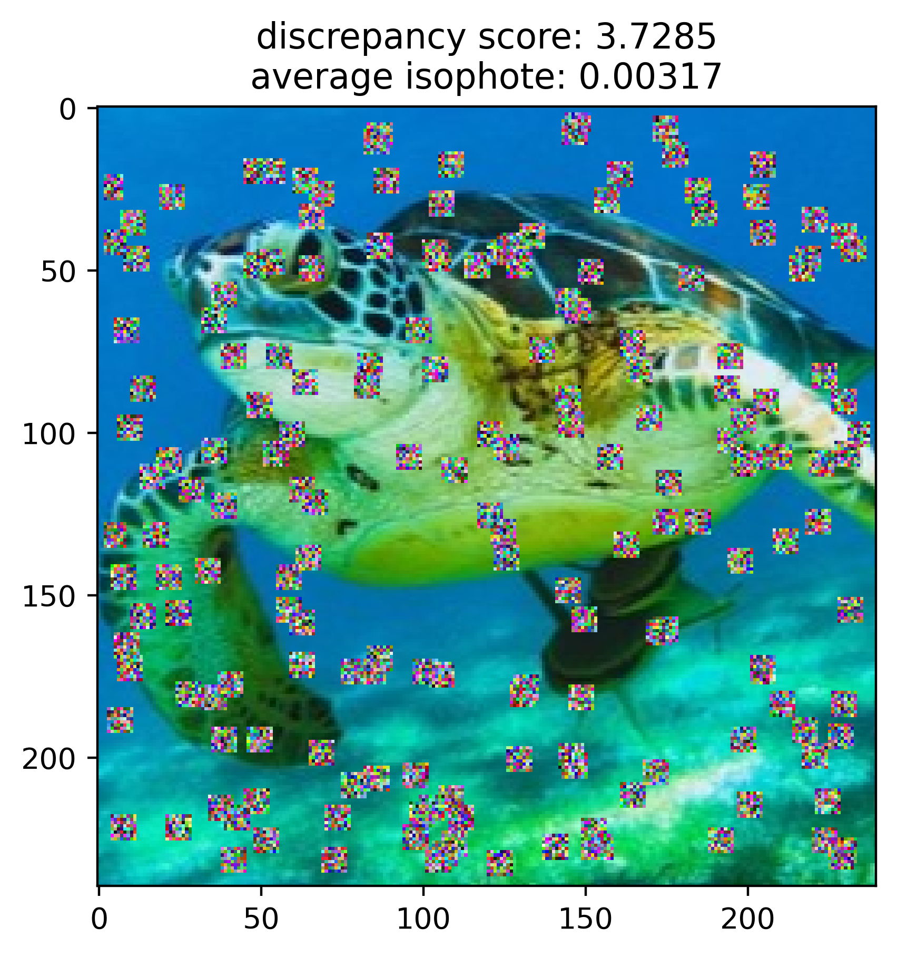
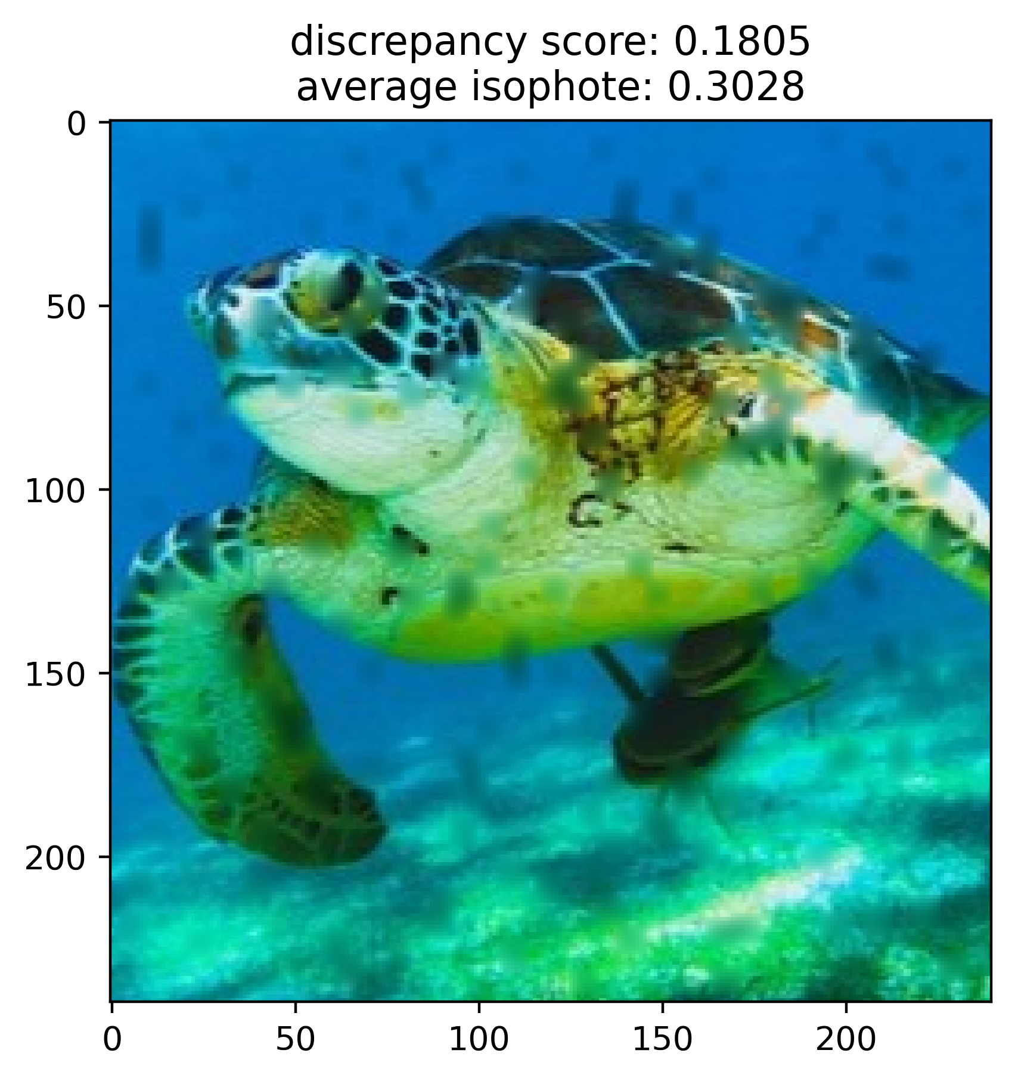

ShowCase of different Masks and Algorithms
distorted | DiffusionV1 | DiffusionV2

Slide 31


ShowCase of different Masks and Algorithms
distorted | Laplace | Navier

Slide 32
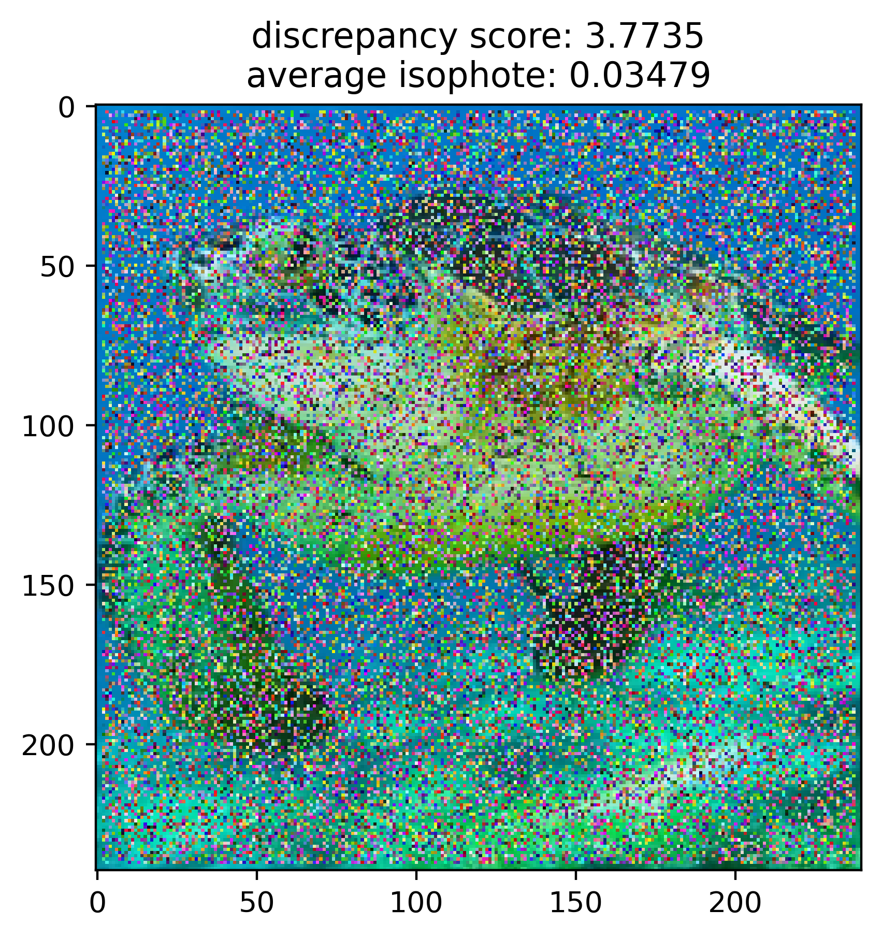


ShowCase of different Masks and Algorithms
distorted | DiffusionV1 | DiffusionV2

Slide 33
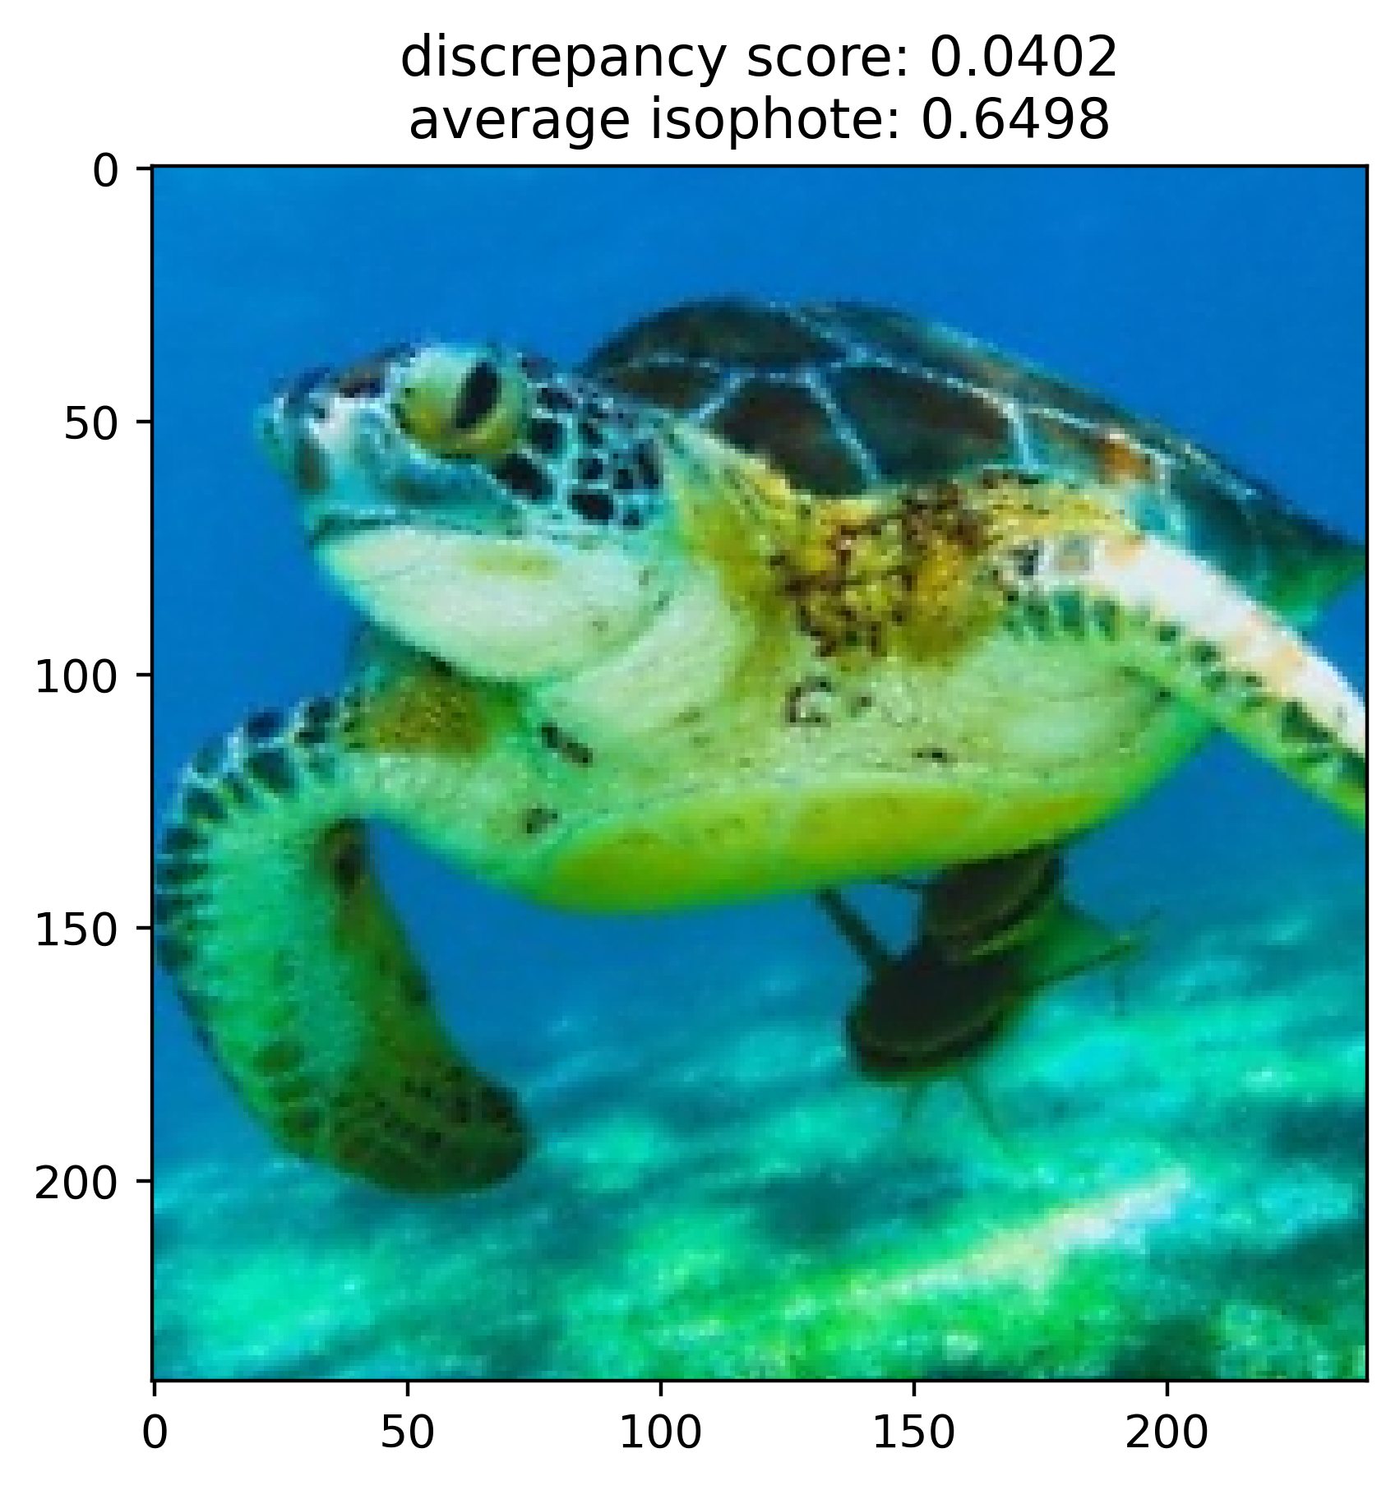

ShowCase of different Masks and Algorithms
distorted | Laplace | Navier

Slide 34
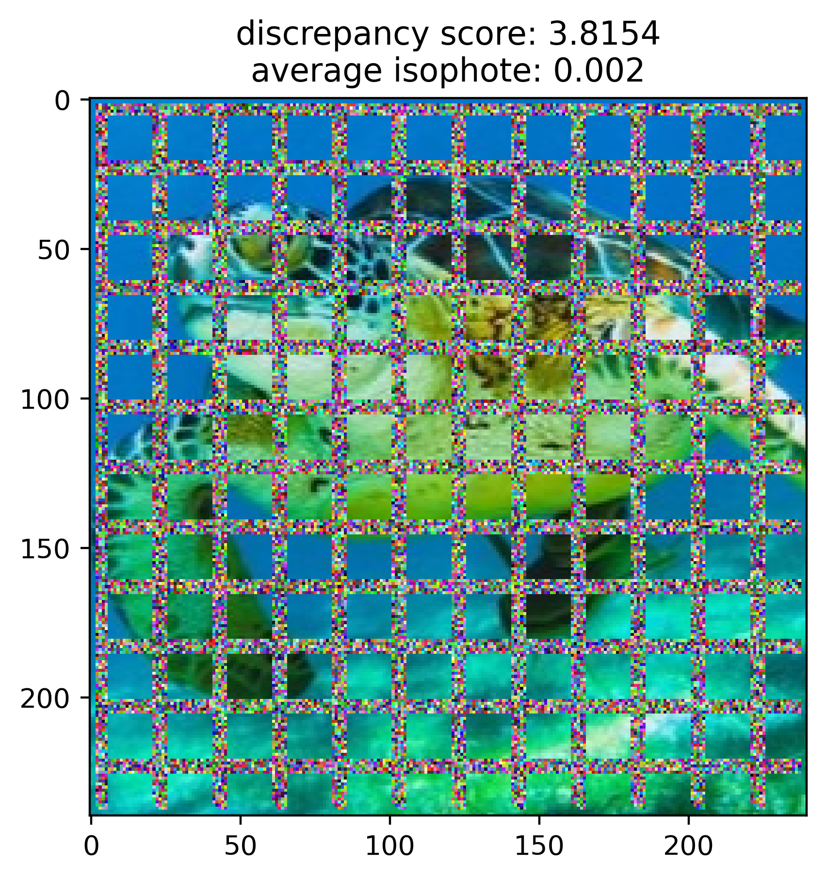

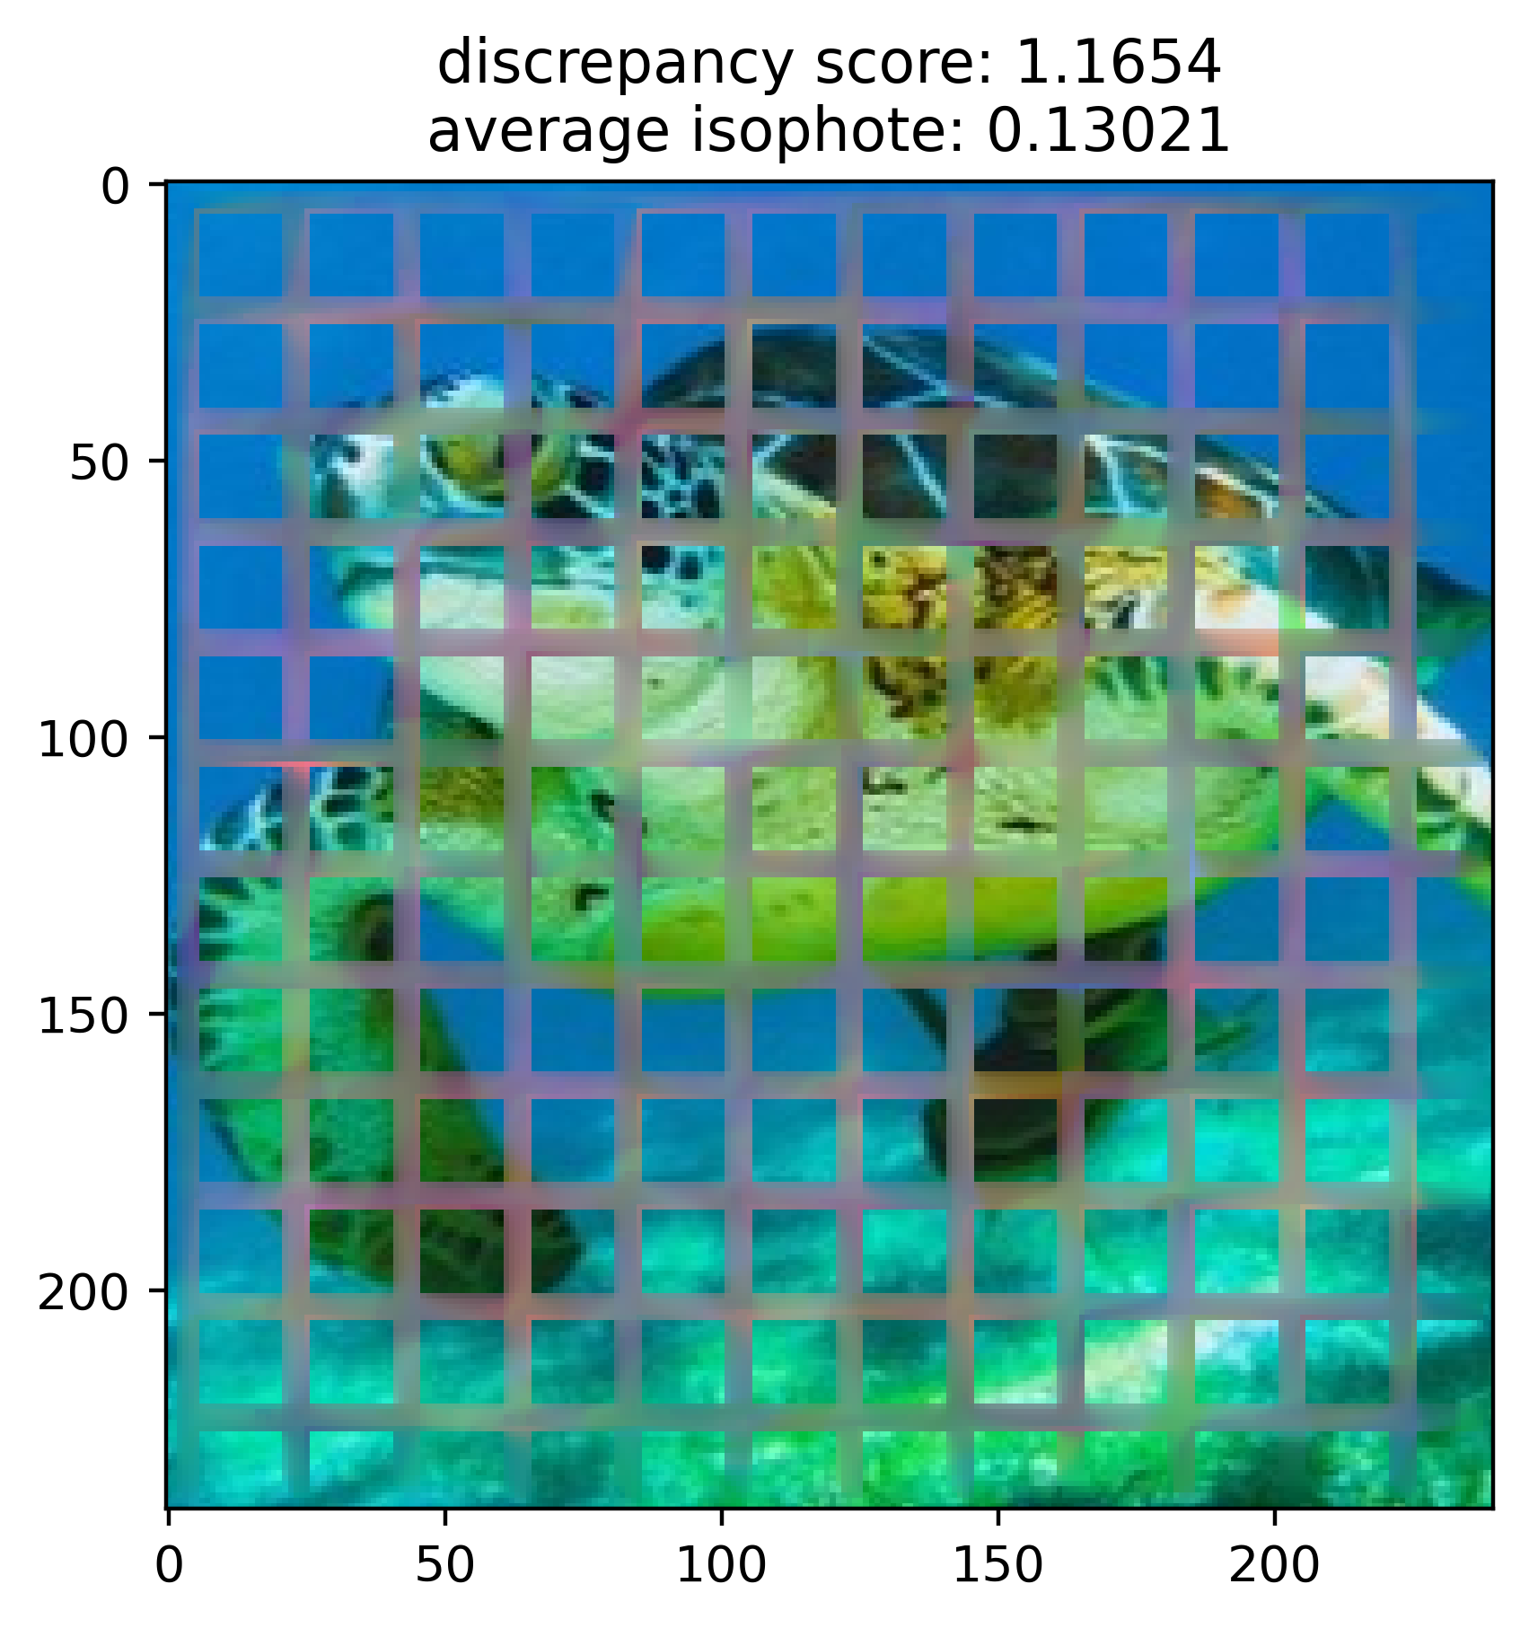
ShowCase of different Masks and Algorithms
distorted | DiffusionV1 | DiffusionV2

Slide 35


ShowCase of different Masks and Algorithms
distorted | Laplace | Navier

Slide 36
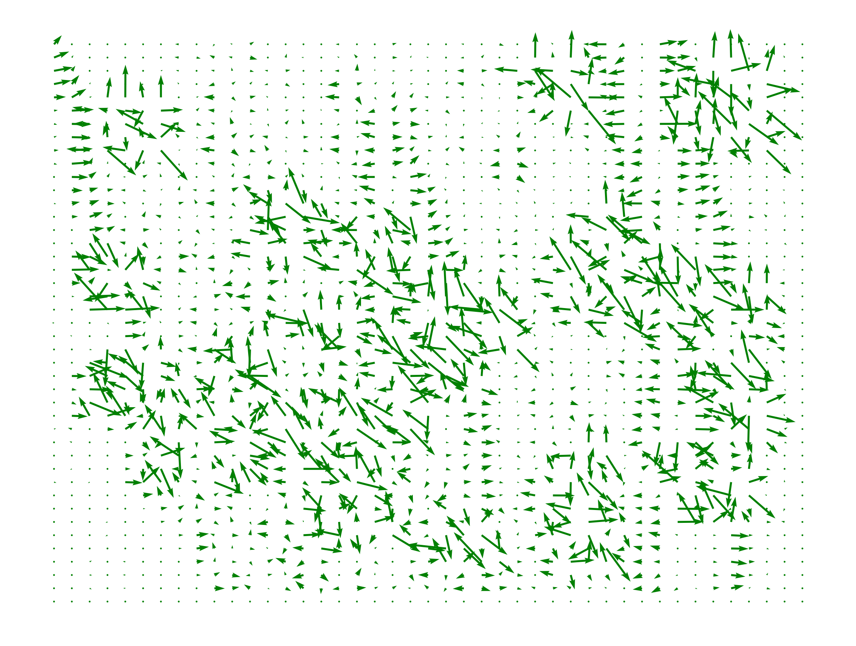

Slide 37
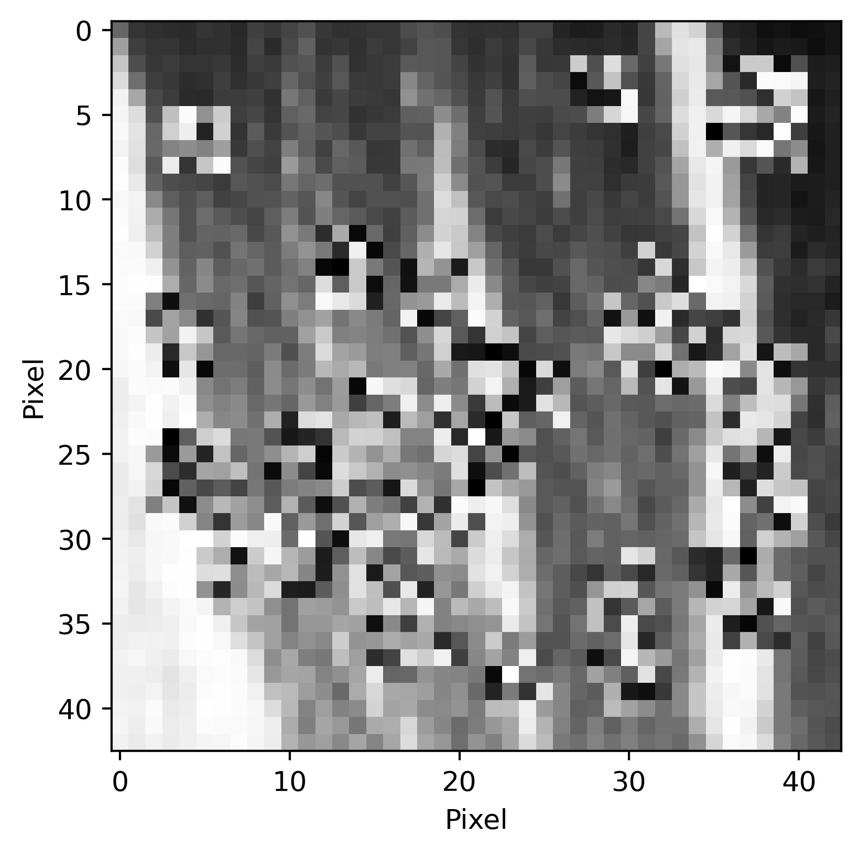

Slide 38
